Slide 1
Week 1 Intro to DBMS

Slide 2
When to use DBMS
Use Cases
Considerations
When data has an audience who may need to acquire or use the data for known or unknown purposes
Applications need a medium to store their inputs and outputs
Transactional systems need to be able to read and modify their data in real time for customers
Data types, structures, and constraints need to be understood and defined
How long do we need to store the data
What types of queries will be executed against the database
What types of security constraints are there?
Scale - immense amounts of data may need to be stored on distributed systems

Slide 3

Stages of Database Design
SRS
Define Users
How it will be used
Conceptual Design
ERDs
Logical Design
Requirements
Data models & flow charts
Physical Design
DBMS is built and maintained

Slide 4








Types of Databases
RDBMS – Relational Database Management System – Used to store tabular data in a relational model.
OLTP – Online Transaction Processing – Used for highly transactional use cases. (Bank transactions)
OLAP – Online Analytical Processing – Used for analytic reads, non-transactional.
NoSQL – Used to store unstructured (non tabular data) for web applications
Graph Databases – Used to store GIS data and aids in modeling of highly connected data
Big Data (Hadoop) – Typically built as a file system (HDFS or S3) with a query engine built on top (Spark/Hive). Used to store immense amounts of data in a distributed system.

Slide 5
Characteristics of the DBMS Approach
Collation of files related to the same thing
Self-describing nature of a Database System
Catalog (metadata)
DDL: CREATE, ALTER, DROP, TRUNCATE, COMMENT, RENAME
DML: SELECT, INSERT, UPDATE, DELETE, MERGE, CALL, EXPLAIN, LOCK
DCL: GRANT, REVOKE
TCL: COMMIT, ROLLBACK, SAVEPOINT, SET TRANSACTION
Insulation between programs and data, and data abstraction
Database handles changes in data through ETL process instead of app design
Program-data independence
Support of multiple views of the data
Sharing of data and multiuser transaction processing
Concurrency control
ACID (Atomicity, Consistency, Isolation, and Durability)

Slide 6
Advantages of the DBMS Approach

Slide 7
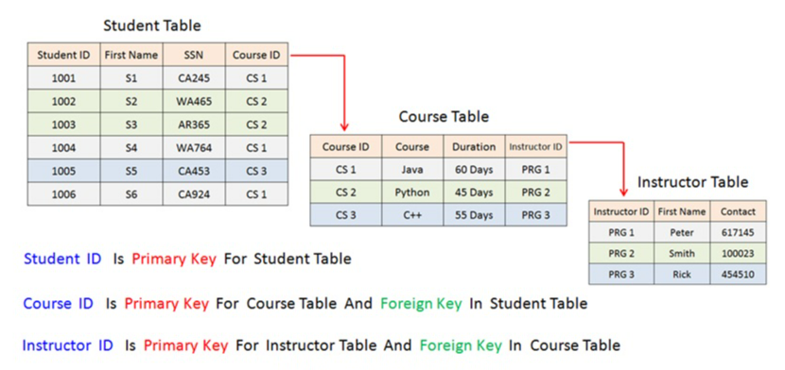
Redundancy Control
Data normalization done through the design process. Ensures data isn’t inserted in multiple locations and relationships are maintained.
Controlled Redundancy – Helps to speed up some queries, potentially for user applications/use cases.
Known as denormalization (NoSQL)

Slide 8
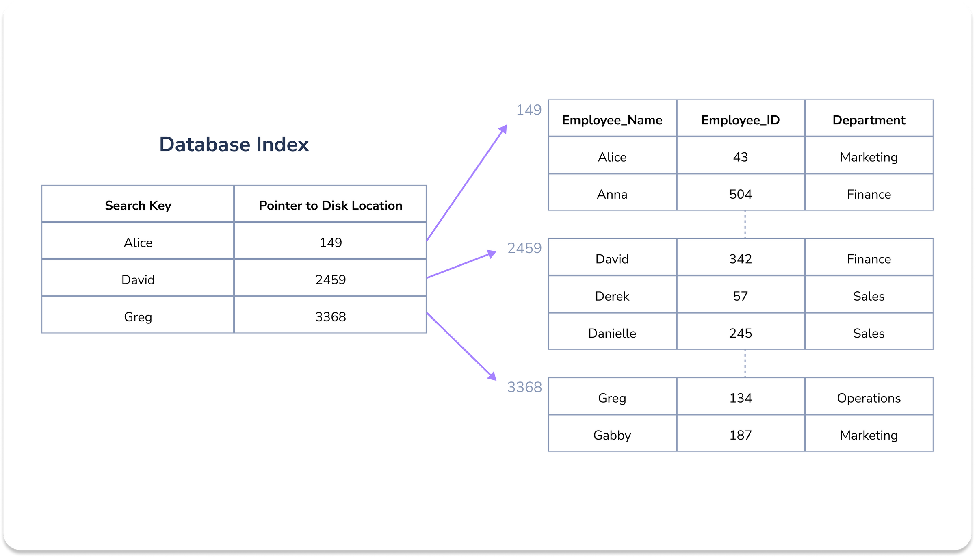
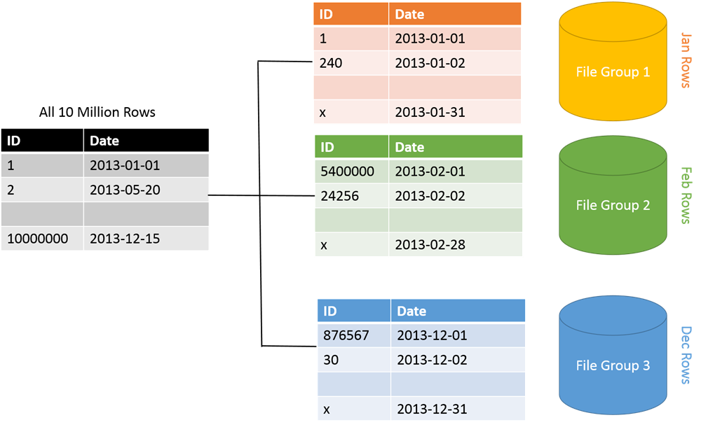
Efficient Search
DBMS must efficiently execute queries and updates.
Indexes
Hash map/tree data structure – search for all rows against the index, points to actual disk location for efficient lookup
Partitions
In file systems there is no real database, files are stored on disk. Columns can be used as partitions to store files with the same value on a partition key.
Caching
Commonly use queries can be stored in memory.
Sharding
A database stores information in multiple datasets consisting of columns and rows. Database sharding splits a single dataset into partitions or shards. Each shard contains unique rows of information that you can store separately across multiple computers, called nodes. All shards run on separate nodes but share the original database’s schema or design.

Slide 9
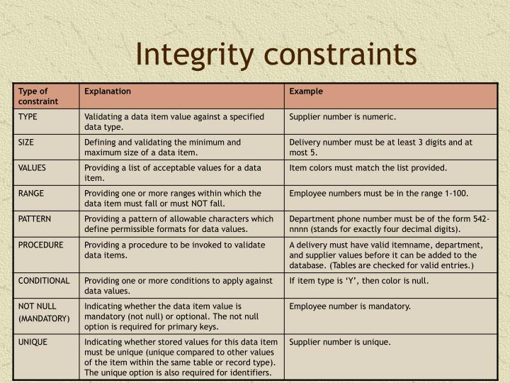
Integrity Constraints
Databases must have constraints that hold for the data such as data type, referential integrity, and key uniqueness.
Referential integrity
Every record from one table must match with every record from another table

Slide 10
More Advantages of the DBMS Approach
Access Controls
User permissions , READ, WRITE, ADMIN etc.
Persistent Storage for Program Objects
NoSQL is great for this
Backup & Recovery
Big data systems typically create copies of the data on multiple nodes in case one node fails
User Interfaces
Relationships
Rules & Triggers
Events & rules for conditions as data comes in (stored procedures)

Slide 11
Data models, schemas, and instances

Slide 12
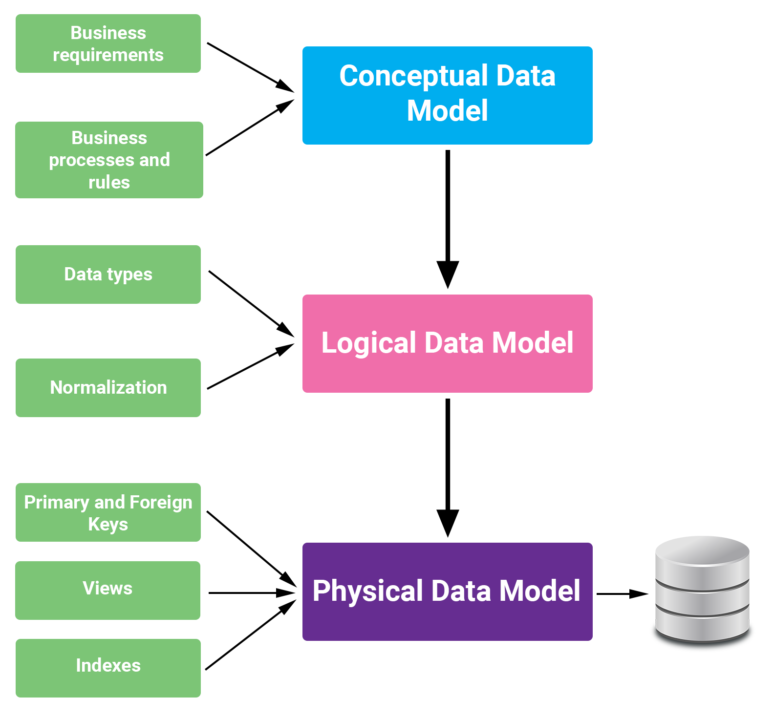
Categories of Data Models
Conceptual Data Model
This model focuses on “what” the data system contains, not how the data is processed, or its physical characteristics. Its purpose is to organize and define business concepts and rules, while describing entities, their attributes, and their relationships.
Logical Data Model
The logical data model contains more detail than the conceptual data model and includes all the entities, relationships, attributes and rules that apply to the data. This type of model is used to design the database.
Physical Data Model
They provide a schema for how the data will be physically stored within a database.

Slide 13
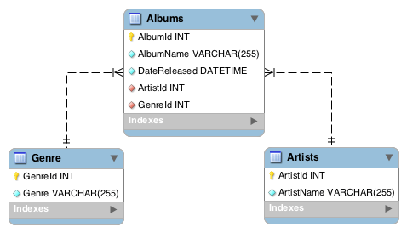
Schemas, Instances, and Database States
Schema
The description of the database, oftentimes a physical database instance will have multiple schemas which contain interrelated tables and views.
State/Instance
A current snapshot of the database, states can have rollback functionality.
Valid states satisfy the structure and constraints of the database

Slide 14
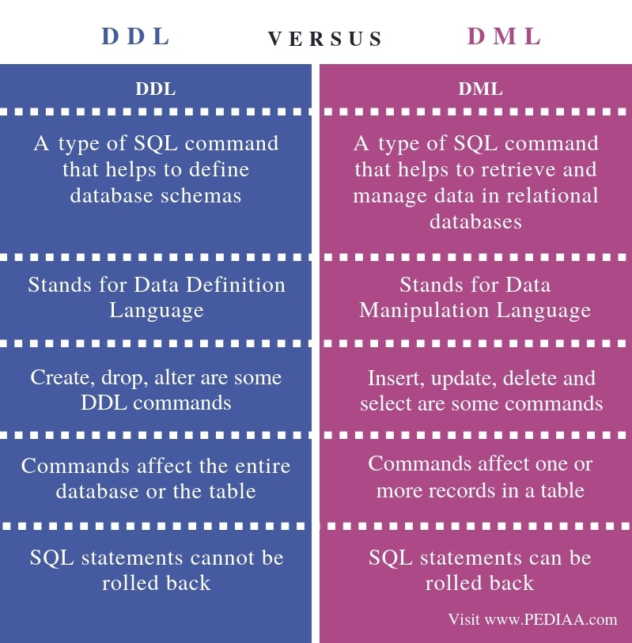
Database Languages
DDL – Data Definition Language
CREATE, ALTER, DROP, TRUNCATE, COMMENT, RENAME
SDL – Storage Definition Language
almost anything that’s not specified by SQL standard. It is different in every DBMS which specifies anything to do with how or where data in relevant table is stored
VDL – View Definition Language
used to specify user views and their mapping to conceptual schema. It defines the subset of records available to classes of users. It creates virtual tables and the view appears to users like conceptual level. Many times the DDL will handle this
DML – Data Manipulation Language
Low Level (Procedural)
SELECT, INSERT, UPDATE, DELETE, MERGE, CALL, EXPLAIN, LOCK
High Level (Nonprocedural)
Typically done through the UI

Slide 15
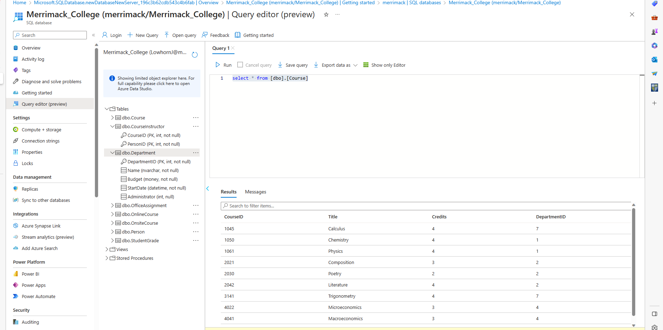
DBMS Interfaces
Menu Based Interfaces
Mobile Apps
Form Based Interfaces
Graphical User Interfaces
Natural Language Interfaces
Keyword-based Database Search
Speech Input and Output
Interfaces for Parametric Users
Interfaces for the DBA

